Slide 1

A Data Science Project : Music Recommendation System
Discover the power of music recommendation systems and learn how we developed a cutting-edge system to enhance user experience and satisfaction. Discover new tunes, create your perfect playlists, and indulge in musical bliss.
Presenters :
Shivangi Thakur
Pavan Raju
Sanjeev Raj
Anand Venkata
Prajakta Kutul
Abhishek Warfade

Slide 2

Why Music Recommendation?
1
Information overload 🤯
2
Personalization 🎧
Everyone has a unique taste in music, and recommendation engines can cater to them.
The amount of music available is immense and can be overwhelming.
3
Discovery 🔍
Recommendations can lead music lovers to discover new genres, artists, and tracks they might have missed otherwise.

Slide 3
Introduction
What is a music recommendation system?
Importance of music recommendation systems
Overview of the project
Get an overview of our data science project on building a music recommendation system.
Explore the concept and functionalities of music recommendation systems.
Understand the impact of personalized music recommendations on user engagement and retention.

Slide 4
Know more about Music Recommender System:
The Recommender System is a software application and algorithm that provides suggestions for items that a user is most interested in.
Recommendations are used in a variety of real-world situations, such as deciding what products to buy, listening to music, or reading the latest news.
Now talking about the Music Recommendation System, the availability of digital music is now abundant due to the new business model in the music industry.
As a result, the importance of a music recommender system for music suppliers cannot be overstated. It is foreseeing.
Collaborative filtering makes suggestions based on the collaborative power of the available evaluation by users.
It is assumed that if people rate music things similarly or behave similarly, they would rate other music items similarly as well.

Slide 5
Importance of Music Recommendation System:
Provide quality and immersive customer streaming experience
Make your platform maximum personalized
Increase satisfaction and engagement of your customers
Make it convenient to use your service, with no need to waste time finding new songs
Automate curating and playlisting audio
Get insights about users’ behavior and make data-based marketing decisions.

Slide 6
Overview:
With the rise of digital content distribution, we have access to a huge music collection. With millions of songs to choose from, we sometimes feel overwhelmed. Thus, an efficient music recommender system is necessary in the interest of both music service providers and customers.
Our music recommender system is large-scale and personalized. We learn from users’ listening history and features of songs and predict songs that a user would like to listen to.

Slide 7

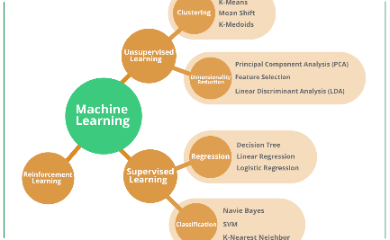

How It Works
Data Analysis
Algorithm
Application
The system collects data from various sources such as music streaming platforms, social media, and user preferences.
Using sophisticated machine learning techniques, the algorithms learn about the user's preferences and suggest similar music.
The system integrates with music streaming applications like Spotify or Apple Music and recommends personalized playlists to the user.

Slide 8
Project Workflow:
Understanding the objectives
Importing the necessary libraries
Loading the Dataset
Data Understanding
Data preprocessing
Exploratory Data Analysis (EDA)
Feature Scaling
Data Visualization
Model Building using User Based Collaborative Filtering(UBCF)
Model Training and Testing
Model Deployment

Slide 9
Project Objective:
To build a feature of recommendation system to support a music application
User listening history and music information
Music Recommender System
Prediction of songs that user will listen to

Slide 10
How does the system work?
Recommendation Algorithms
Sophisticated algorithms analyze the collected data to generate personalized recommendations based on user preferences, genre preferences, and more.
How does the system work?
1
Data Collection & Analysis
Massive amounts of data are collected from various sources, including user listening habits, artist information, and social media trends.
Recommendation Algorithms
2
Sophisticated algorithms analyze the collected data to generate personalized recommendations based on user preferences, genre preferences, and more.
3
User Interface
The user interface of the music recommendation system presents the recommendations in an intuitive and user-friendly way for easy exploration and discovery.

Slide 11

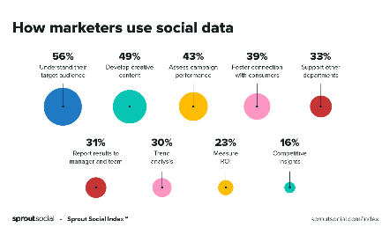

Data collection and analysis
User Listening Habits
Social Media Trends
Artist Information
Analyzing user listening habits helps determine musical preferences, favorite genres, and frequently played artists.
By monitoring social media platforms, the system captures emerging trends and identifies popular songs, artists, and genres.
Collecting data about individual artists, their style, collaborations, and attributes helps in creating meaningful recommendations.

Slide 12
Data Collection and Analysis
1
Data Collection
The music streaming platforms are the primary data source for the recommendation engine. The system also collects data from social media, user searches, and purchase history.
Pre-processing
2
The data might contain noise and irrelevant metadata. Pre-processing the data using techniques such as feature scaling, normalization, and outlier removal helps clean the data.
3
Analysis
Statistical analysis and data visualization techniques such as PCA are used to understand the underlying patterns and correlations in the data. This helps in getting better recommendations.
Feature extraction
4
Explore the process of extracting key features from the music data for effective recommendations.

Slide 13
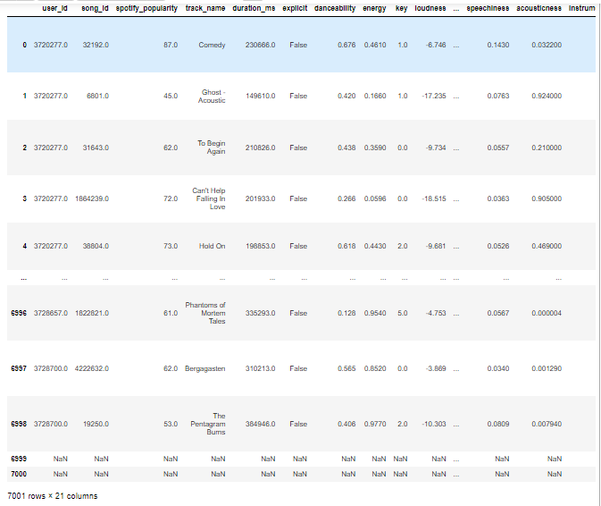
After understanding the objective of the project and then importing all the necessary libraries, we will import the required dataset in csv format. Our dataset consist of 7001 rows and 21 columns in total.

Slide 14
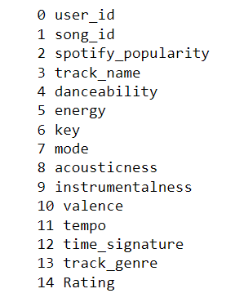
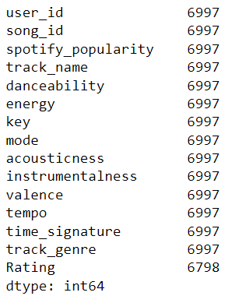
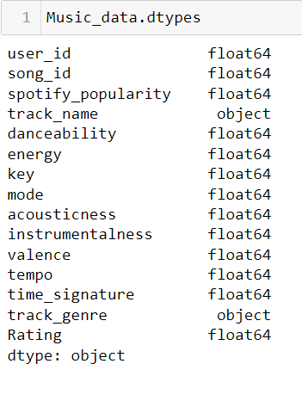
Data Understanding:
Columns/Features of our dataset
Total count
Data type

Slide 15
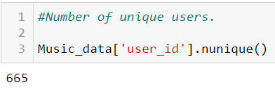
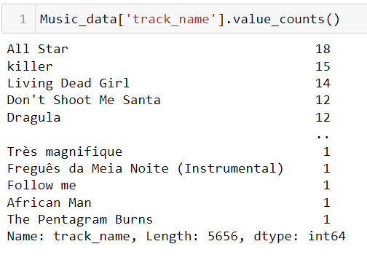
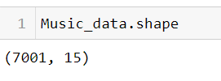
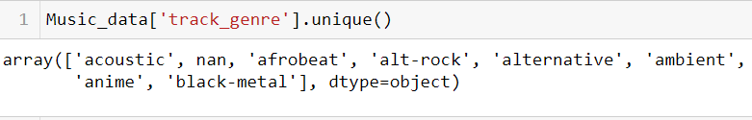
Data understanding continues...
Shape of dataset

Slide 16
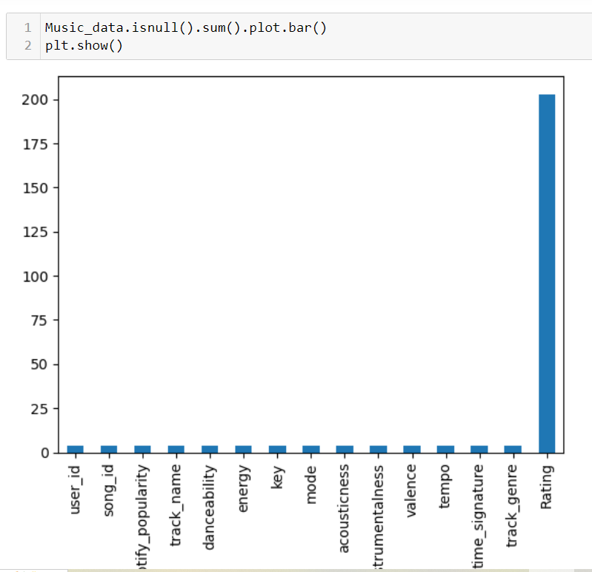
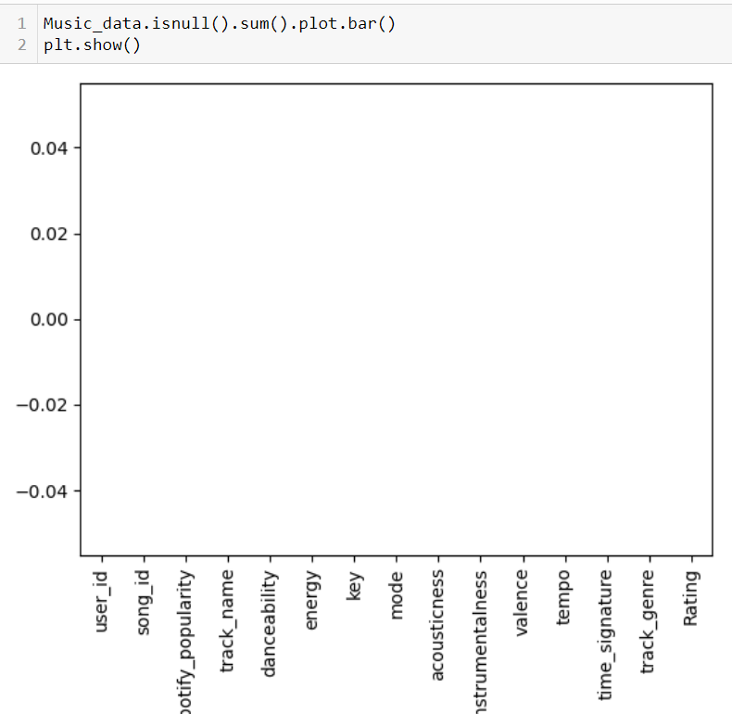
Exploratory Data Analysis (EDA) || Data Preprocessing
Finding out the null entries
Removing all the null entries

Slide 17
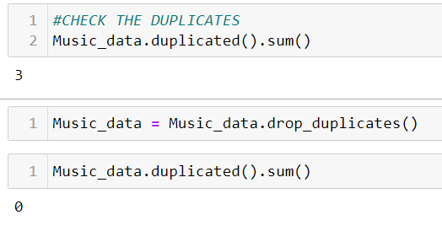
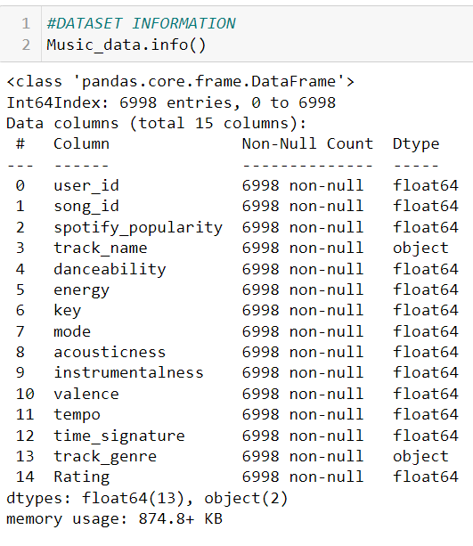
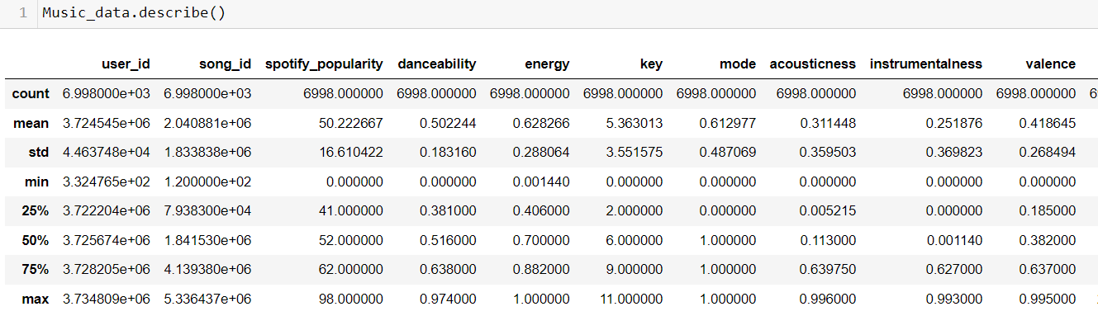
After removing all the three duplicate datapoints.
Dataset Information
Describing the datasets

Slide 18
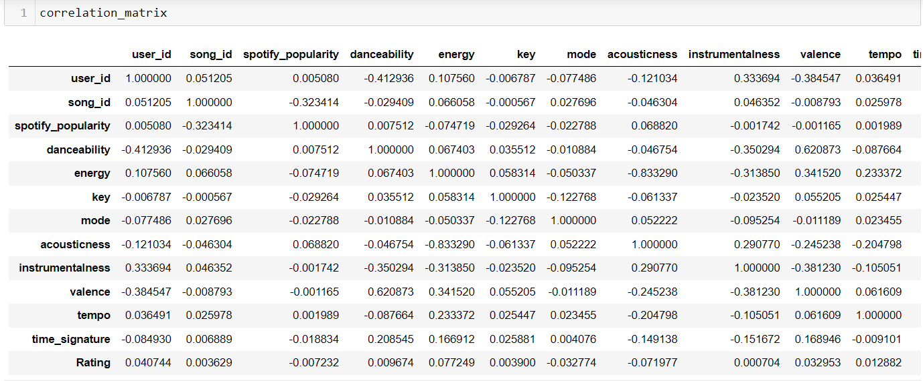
Data Analysis using Visualization

Slide 19
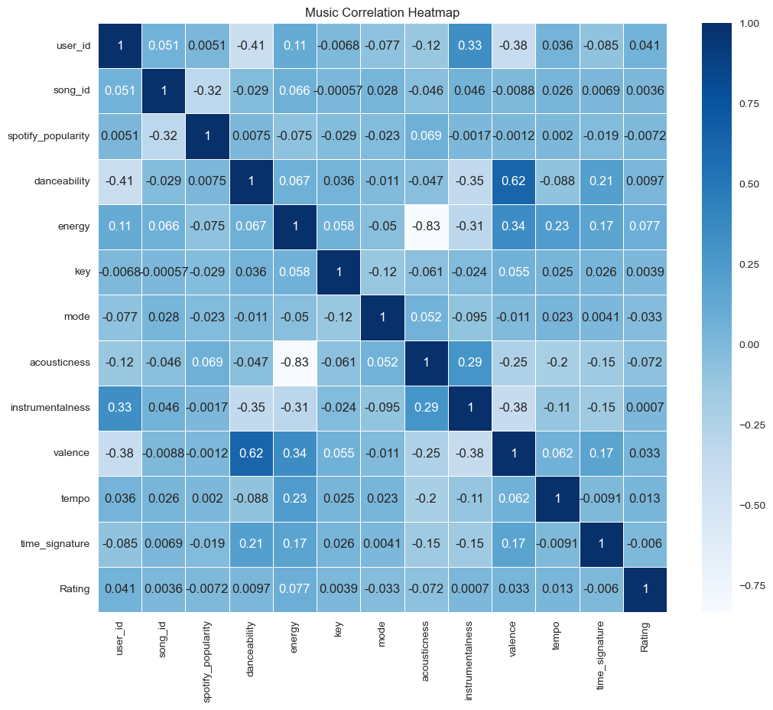
Pairplot for plotting pairwise relationships between variables within a dataset
Correlation Heatmap

Slide 20
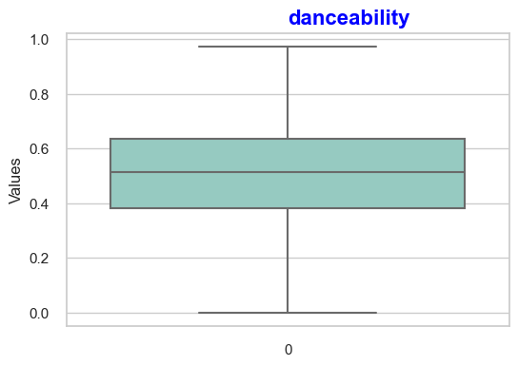
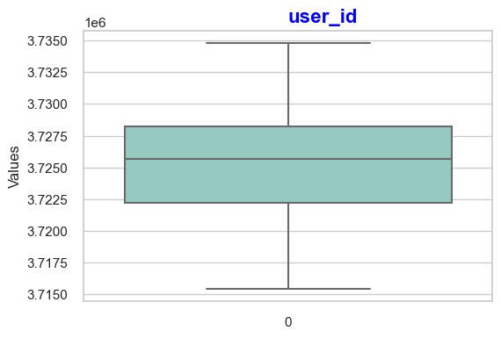
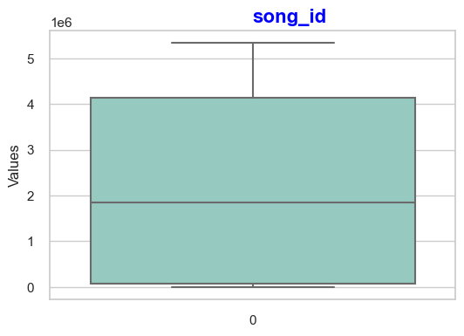
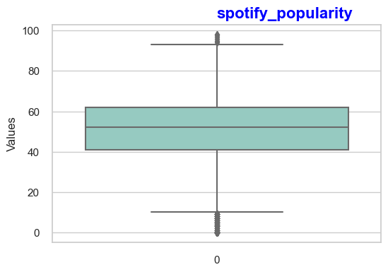
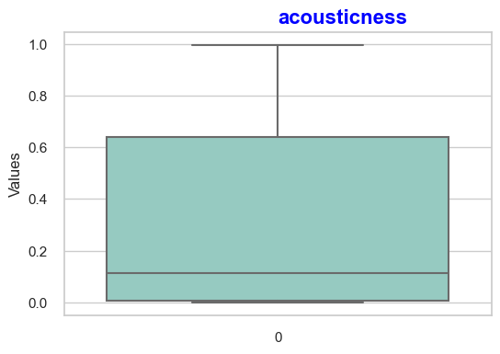
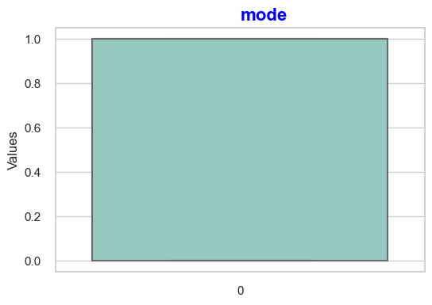
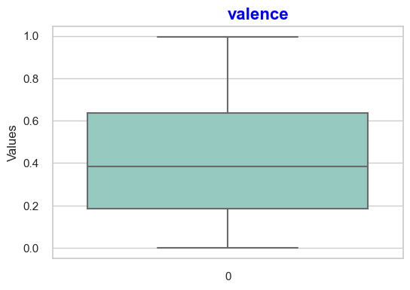
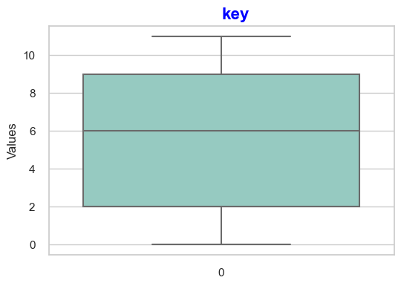
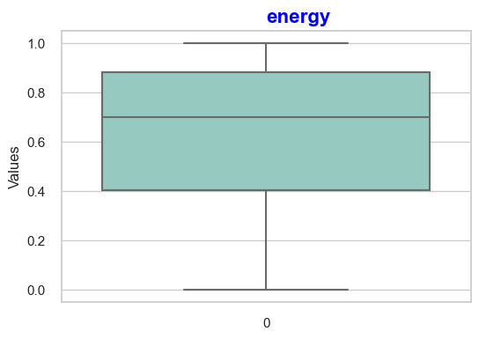
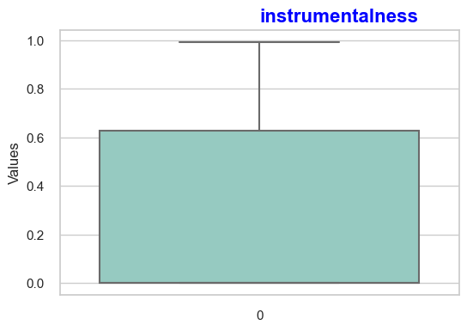
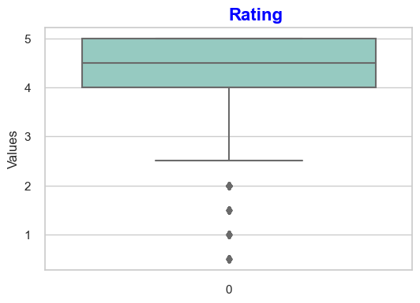
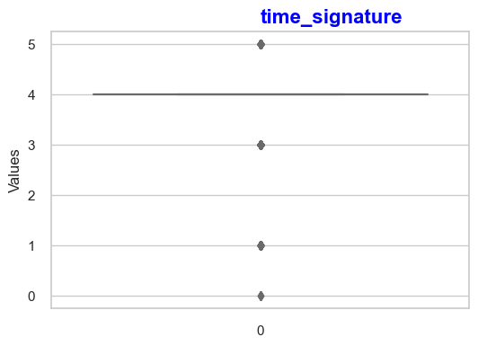
Boxplot for outlier detection

Slide 21
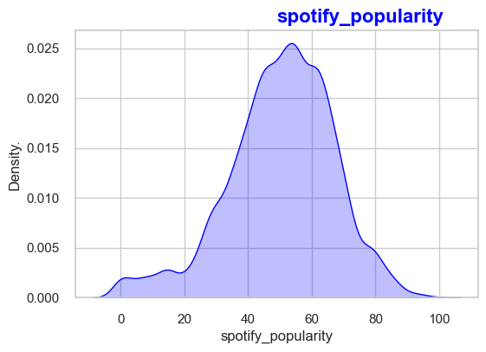
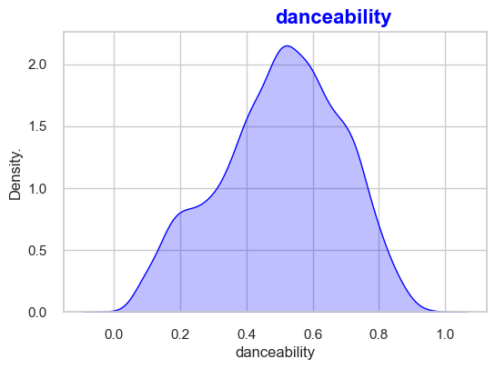
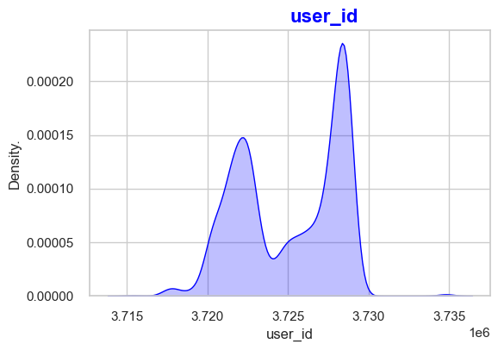
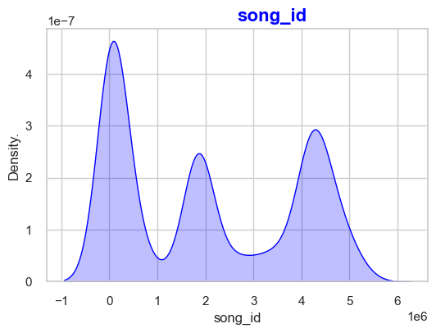
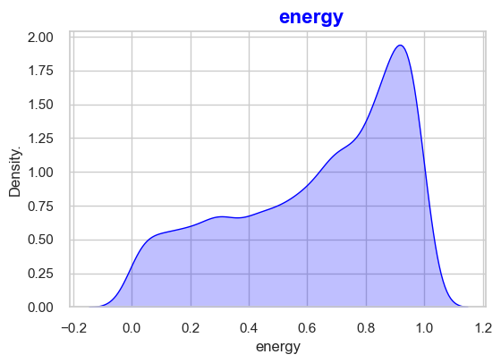
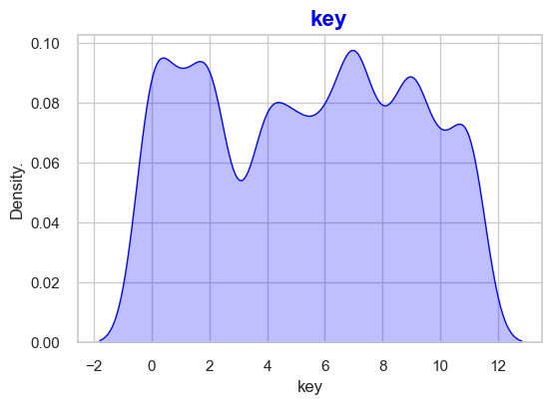
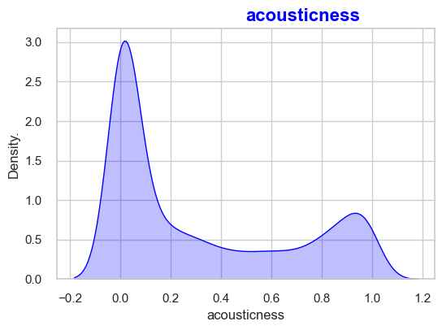
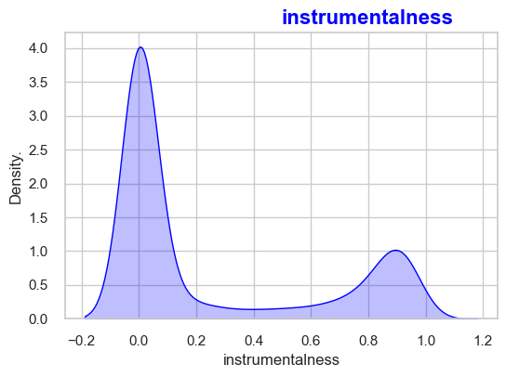
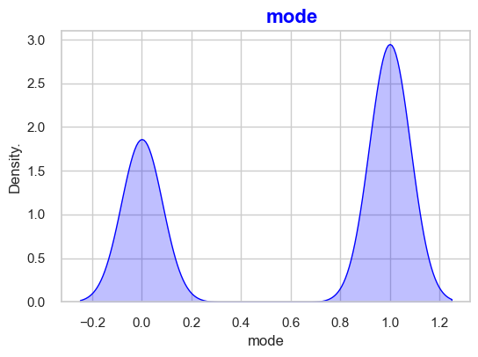
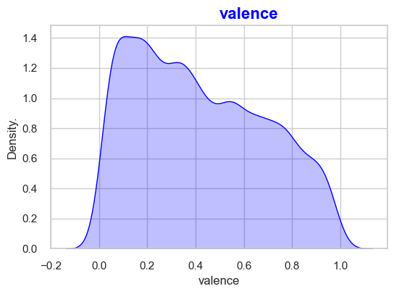
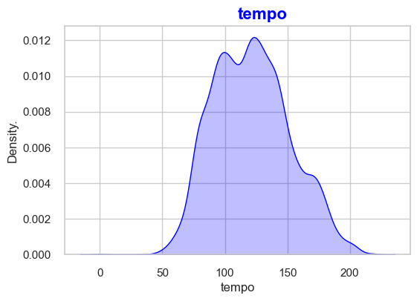
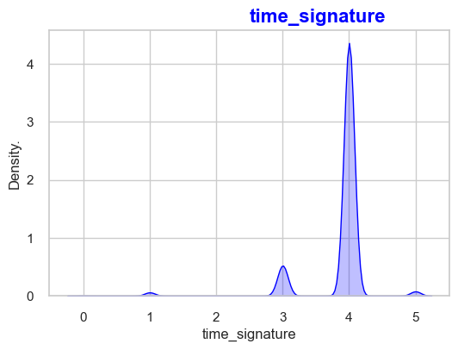
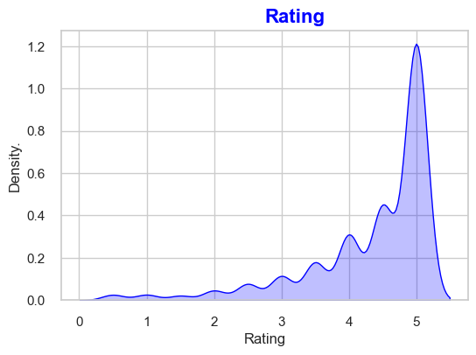
Density Visualization

Slide 22
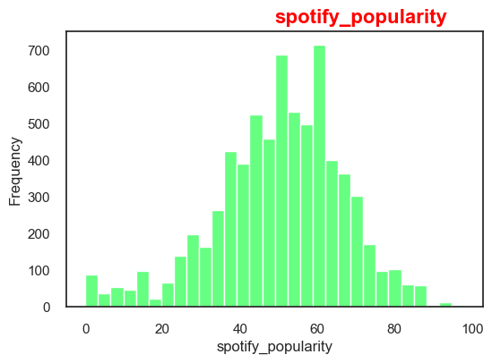
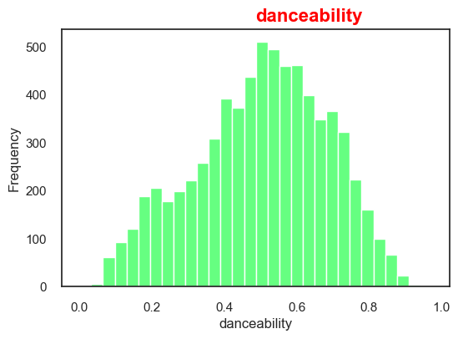
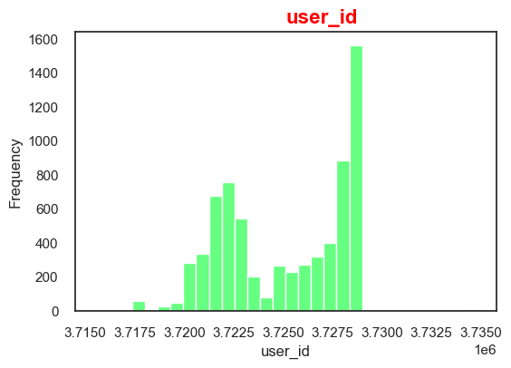
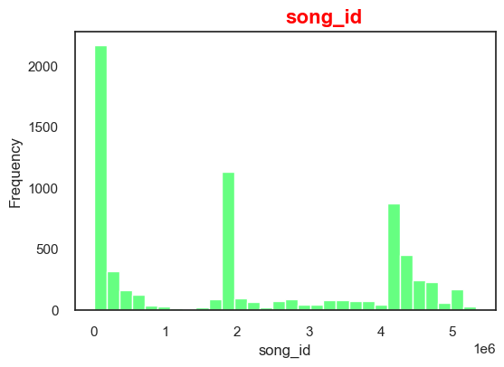
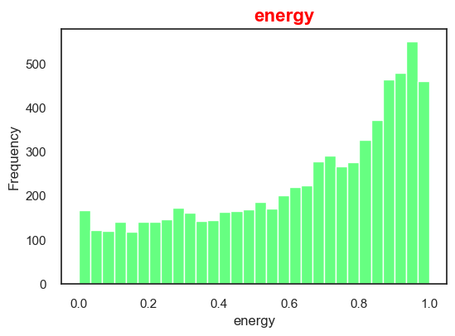
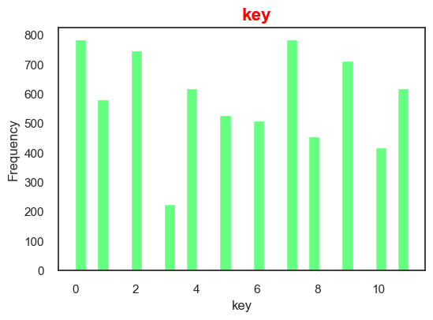
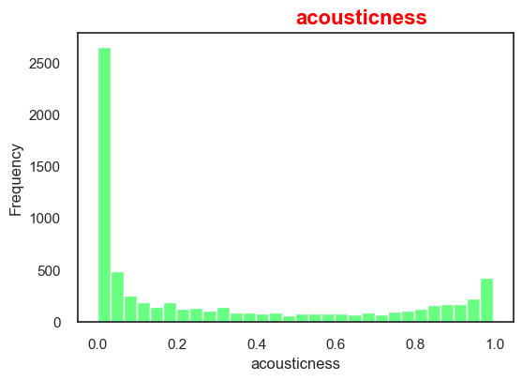
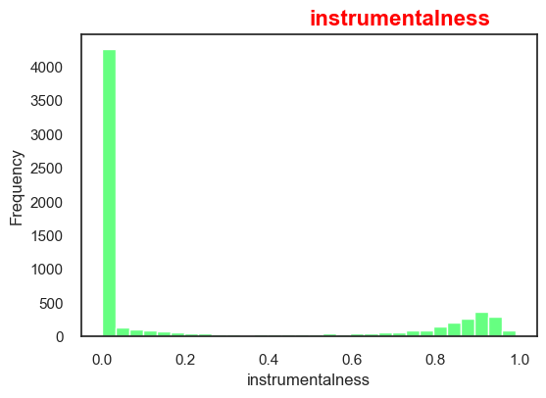





Histogram Visualization

Slide 23
Model Building with Recommendation algorithms :
Content-Based Filtering
Hybrid Approaches
Collaborative Filtering
Combining collaborative filtering and content-based filtering techniques, hybrid algorithms offer comprehensive and diverse music recommendations.
By analyzing the listening patterns and preferences of similar users, the system recommends songs and artists that align with your taste.
Based on the attributes of songs and artists you enjoy, the system suggests similar tracks and musicians that match your musical preferences.

Slide 24



TYPES OF RECOMMENDATION SYSTEM
Content Based Filtering Collaborative Filtering
liked by user
read by both users
similar books
Recommended
to user
similar users
Recommended
to him
liked by her
Measure similarity between books
Example: cosine similarity
Process: Text Vector using TfidfVectorizer
Memory-based:
Predict ratings by learning user’s pattern of giving ratings. Example: KNN
Model-based:
Predict ratings by learning user latent factor and item latent factor. Example: SVD, SVD++

Slide 25
Content Based Filtering
Content-based filtering uses item features to recommend other items similar to what the user likes, based on their previous actions or explicit feedback.
This filtering makes recommendations by using keywords and attributes assigned to objects in a database and matching them to a user profile.
Content-based filtering uses similarities in products, services, or content features, as well as information accumulated about the user to make recommendations.
Content-Based recommender system tries to guess the features or behavior of a user given the item’s features, he/she reacts positively to.
Collaborative Filtering
Collaborative filtering method can filter out items that a user might like on the basis of reactions by similar users.
This method utilizes preferences and behaviors of other users to come up with recommendations.
The general operation of these systems is to pair users with similar tastes together into groups. Recommendations are then made based on the collective preferences of the users within each group.
Thus if user x and user y are both members of the same preference group, and user x likes a particular sample, then there should be a high probability that user y also like this sample. Obviously, this method requires a significantly large initial dataset to provide relevant predictions.

Slide 26



Before moving further, lets explore more about the songs of our data set.
A song is listened for an average of 2.203 users, with minimum 1 and maximum 53 users.

Slide 27
Model Building: Model selection and implementation
1
Overview of different models
Compare and evaluate different models used for music recommendation systems.
Evaluation of model performance
2
Examine the performance metrics and evaluation methods used to assess the effectiveness of our model.
3
Implementation of the chosen model
Learn about the step-by-step implementation of our selected model for music recommendations.

Slide 28


Overview of different models:
Feature (X) : Danceability, Energy, Key, Mode, Acousticness, Instrumentalness, Valence, Tempo, Time signature
Target (Y) : Spotify Popularity
1. Linear Regression:
2. Random Forest Regressor
Mean Squared Error: 1.061711283186876
Mean Absolute Error: 0.8000961177705082
Mean Absolute Percentage Error: 692100.6050998819
Mean Squared Error (MSE): 0.9529041060048986
Mean Absolute Percentage Error (MAPE): 42762.81483899972

Slide 29


3. K Neighbors Regressor
4. Decision Tree Regressor
Mean Squared Error: 1.1313030223149874
Mean Absolute Error: 0.8239143821498605
Mean Absolute Percentage Error: 9118094.961393878
Mean Squared Error: 1.868105736537806
Mean Absolute Error: 1.0662343074105876
Mean Absolute Percentage Error: 11397315.334467398

Slide 30

5. XGB Regressor
Mean Squared Error: 1.1491712477813893
Mean Absolute Error: 0.8311533711594499
Mean Absolute Percentage Error: 1999235.1559749127

Slide 31


6 . Cosine Similarity: Final Model To Recommend
The metric cosine similarity assesses how similar two or more vectors are.
The cosine similarity is the cosine of the angle between vectors. In most cases, the vectors are non-zero and belong to the inner product space.
It is formally described as the difference between the dot product of vectors and the product of the Euclidean norms or magnitude of each vector.
The closer the cosine value to 1, the more similar the two vectors are.

Slide 33

Creating User-Item Matrix for User and Songs genre Recommendation

Slide 34

Finding out the similarities between the users by using ‘ Cosine Similarities Matrix ’
Cosine value
∝
Similarity

Slide 35

Finding out the most similar users.
We have used the most common recommendation algorithm i.e. "user-user” algorithm because it recommends an item to a user if similar users liked this item before.
The similarity between two users is computed from the amount of items they have in common in the dataset
.

Slide 36


Encoding all categorical data (features) to numbers(tags) before fitting and evaluation of the model.
Assigning track name to their respective tags

Slide 37

The final result:

Slide 38
Deploying the system
Selecting an appropriate deployment platform
Scaling the system for large user bases
Ensuring system stability and reliability
Find out how we ensured the scalability of our system to cater to a growing user base.
Choose the ideal platform to deploy our music recommendation system for maximum accessibility.
Learn about the measures taken to maintain the stability and reliability of the recommendation system.

Slide 39

Importing Streamlit and Pickle

Slide 40

Running Streamlit

Slide 41

Click Recommend to Recommend the songs Similar to the selected song

Slide 42


Slide 43

Conclusion
1
Recap of the project
2
Impact of the music recommendation system
This assignment provided us with a fantastic learning opportunity. We've studied data mining, data cleaning, visualization, Model building and a lot more while working on this project.
This recommendation engine make your platform maximum personalized. It automate curating and playlisting audio.
This system provide quality and immersive customer streaming experience and also get insights about users’ behavior and make data-based marketing decisions.
3
Future enhancements and possibilities
We were unable to create a model utilizing singular value decomposition and support vector machines due to a lack of time.
Also, there is a lot of potential in combining several dimensions in this music recommender systems. We will try to work on the same in the near future.

Slide 44


